Slide 1
Traffic Management System
phase 5
TEAM MEMBER:
KAVIYA K
ECE-III YEAR,
IOT(IBM INTERNET OF THINGS),
TEAM NAME: TRAFFIC MANAGEMENT
MENTOR NAME : KOWSALYA ECE AP
UNNAMALAI INSTITUE OF TECHNOLOGY, KOVILPATTI

Slide 2
Introduction:
One of the major problems faced in any metro city is traffic congestion. Heavy traffic is a headache for each and every person driving the vehicle and even to the traffic police in controlling the traffic.
Traffic congestion has a negative impact on economy,the environment and the overall quality of life.
There are two ways through which traffic is been controlled
a)Manually
b)Systematically(Controllers)

Slide 3

Advantages of a Smart Traffic Management System
Cleaner, greener, safer, and more accessible roads are a few benefits of implementing IoT and intelligent technology.
It helps with the following:
Reducing traffic jams and accidents on the streets
Ensuring immediate clearance for emergency vehicles
Facilitating safer and shorter commute times
Reducing congestion & energy consumption at intersections
Offering significant productivity benefits with real-time monitoring of crucial infrastructures
Reducing operating costs with efficient traffic management processes
Ensuring compliance with the regulations for reducing the carbon footprint
Saving billions of gallons of fuel wasted every year
Accurate tracking & quick recovery of lost and stolen vehicles

Slide 4
Block diagram
Arduino
IR Module
LEDs
Power Supply

Slide 5
Explanation
The LED have been powered by Arduino UNO(board).It contains a code which uploaded to the board.
And once it simulated LED start’s blinking like a traffic light.
In this 15 second will for Red light 6 second for Yellow light and 20 second for Green light.
IR sensors are used as sensors to detect the density of traffic and Arduino is used as microcontroller.
An Infrared(IR) sensor is used to measure and detect infrared radiation in its surrounding environment.
The PC is interfaced with the microcontroller in order to provide all time traffic control to the administrator.
Which are used in building services to switch on lamps or in alarm systems to detect unwelcome guests.
Effective distance range of 2cm to 80cm.
IR proximity sensors emit infrared light and once light hits an object , It is reflected back to the sensor.
If the power supply cable travels underground ,it is run in a separate RGS conduit from the detector , signal, and communications cables.

Slide 6
import machine
import utime
# Define the LED pins):
led_red.value(1)
led_yellow.value(0)
led_green.value(0)
def handle_yellow_state():
led_red.value(0)
led_yellow.value(1)
led_green.value(0)
def handle_green_state():
led_red.value(0)
led_yellow.value(0)
led_green.value(1)
def handle_yellow_state_short():
led_red.value(0)
led_yellow.value(1)
led_green.value(0)

Slide 7
# State handlers list state_handlers = [ # (state function, time in milliseconds) (handle_red_state, 5000), # Red LED, on for 5 seconds (handle_yellow_state, 3000), # Yellow LED, on for 3 seconds (handle_green_state, 5000), # Green LED, on for 5 seconds (handle_yellow_state_short, 2000) # Short Yellow LED, on for 2 seconds ] def traffic_light(): state = 0 while True: # Get the current state tuple (handler function and sleep time) current_handler_and_time = state_handlers[state] handler_func = current_handler_and_time[0] sleep_duration_ms = current_handler_and_time[1] # Execute the handler function and sleep for the specified time handler_func() utime.sleep_ms(sleep_duration_ms) # Update the state index state = (state + 1) % len(state_handlers) # Run the traffic light sequence traffic_light()

Slide 11
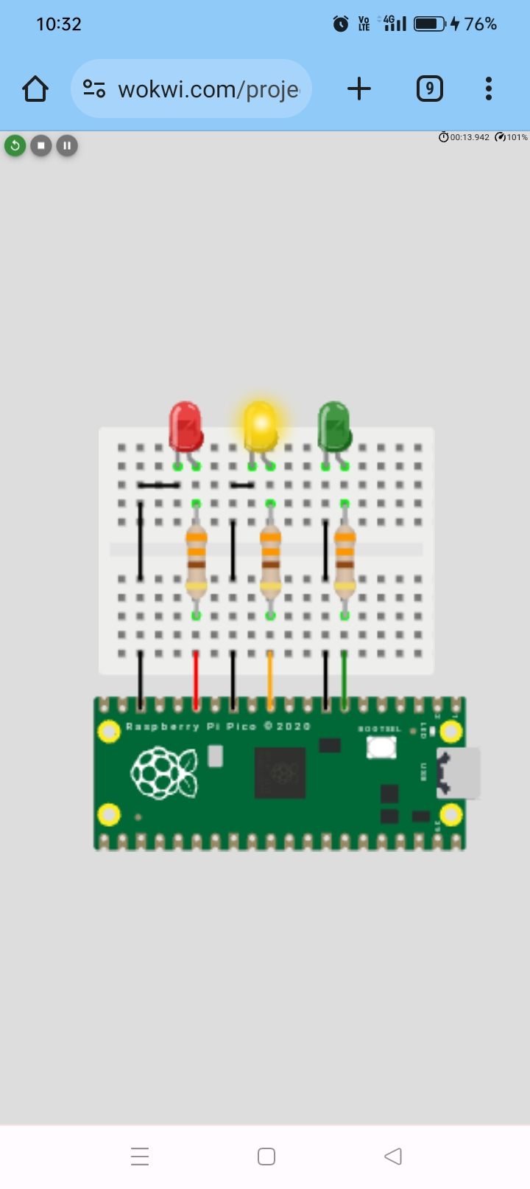

Slide 12


Slide 13

CONCLUSION
The shortcomings of the traditional traffic management system are presented along with the smart traffic control mechanisms employed in a few cities. An efficient system is proposed with the implementation by big data analytics and RFID, supported by IoT. The architecture and functionalities of the proposed system are described along with supervised learning used to determine the attributes of traffic management. This advanced system, once implemented would drastically reduce traffic congestion in big cities and improve the security of vehicles.Traffic management plays a vital role in determining a city’s livability. By using the tracking devices and data effectively – a city government can seamlessly regulate traffic & manage it without expanding the infrastructure. IoT in traffic management can save smart cities a significant chunk of their time, money & resources while making public transport safer and more convenient. Yet IoT will continue to gain momentum in the development & integration of infrastructure and services for future cities.

Slide 14
THANKYOU

